Slide 1
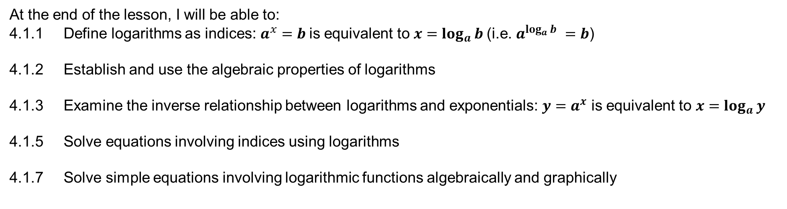
Learning Objective
I will be able to apply the laws of logarithms to solve problems involving indices
Success Criteria
At the end of the lesson, I will be able to:
4.1.1 Define logarithms as indices: $a^{x}=b$is equivalent to $x=\log_{a}{b}$(i.e. $a^{\log_{a}{b}} =b$)
4.1.2 Establish and use the algebraic properties of logarithms
4.1.3 Examine the inverse relationship between logarithms and exponentials: $y=a^{x}$ is equivalent to $x=\log_{a}{y}$
4.1.5 Solve equations involving indices using logarithms
4.1.7 Solve simple equations involving logarithmic functions algebraically and graphically

Slide 2
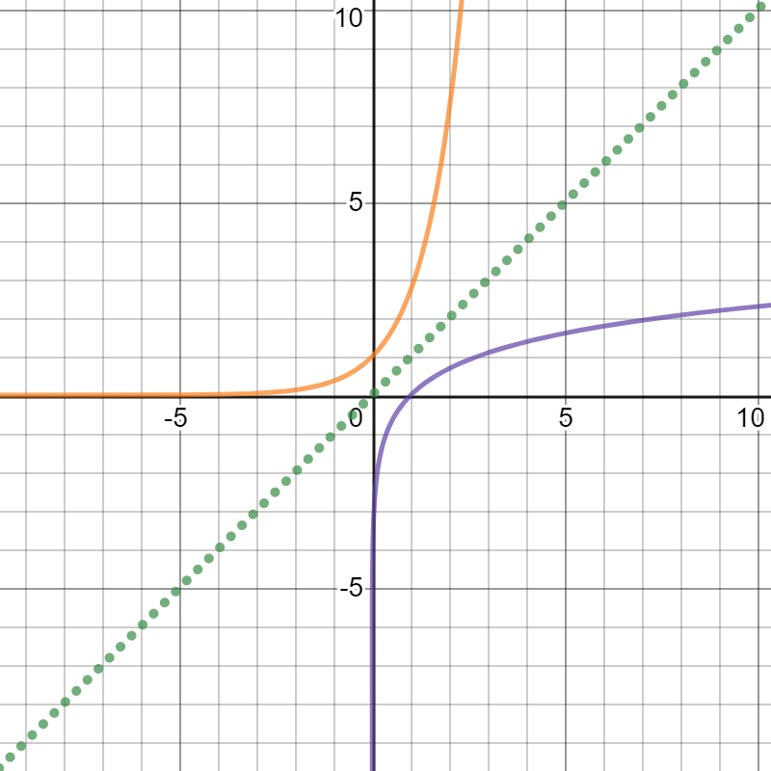
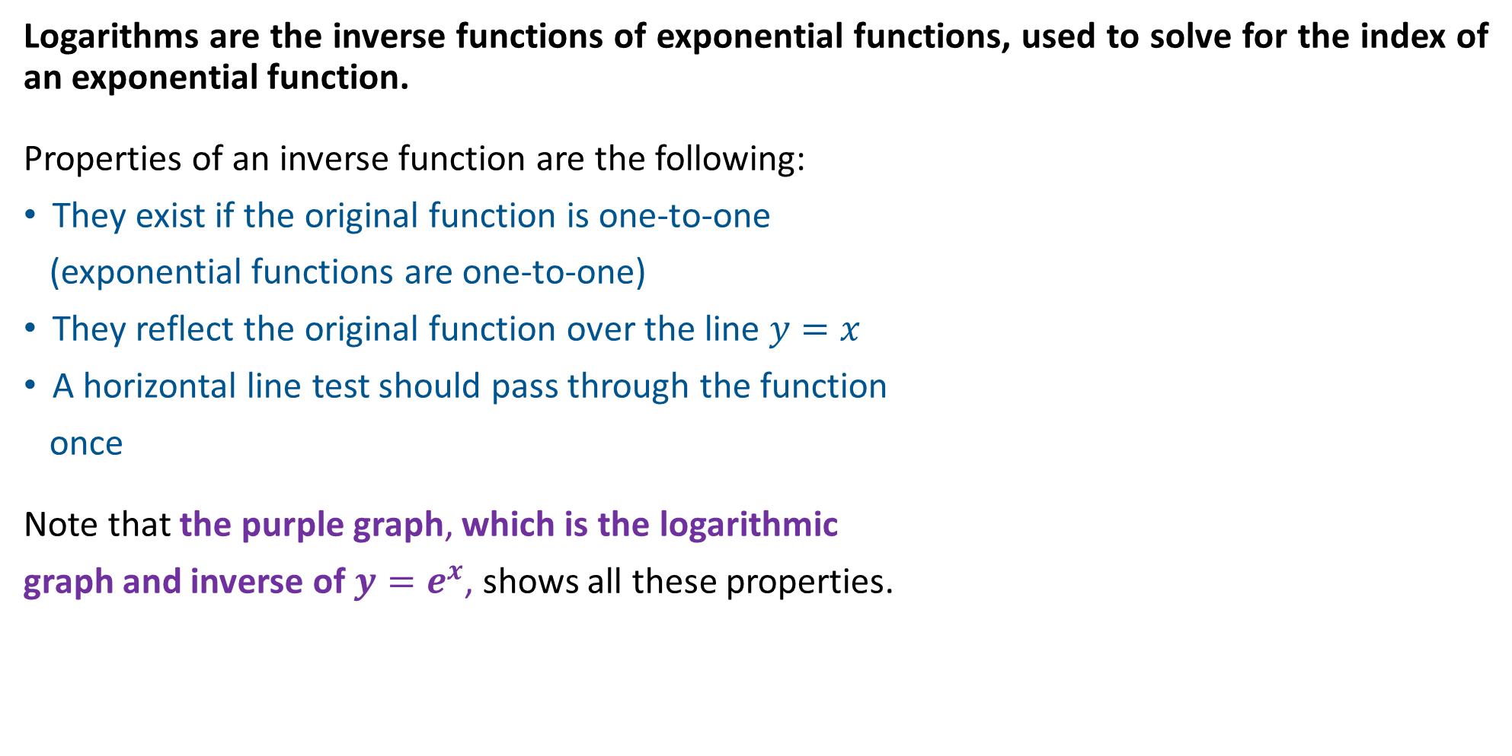
What is a Logarithm?
Logarithms are the inverse functions of exponential functions, used to solve for the index of an exponential function.
Properties of an inverse function are the following:
They exist if the original function is one-to-one
(exponential functions are one-to-one)
They reflect the original function over the line $y=x$
A horizontal line test should pass through the function
once
Note that the purple graph, which is the logarithmic
graph and inverse of $y=e^{x}$, shows all these properties.

Slide 3

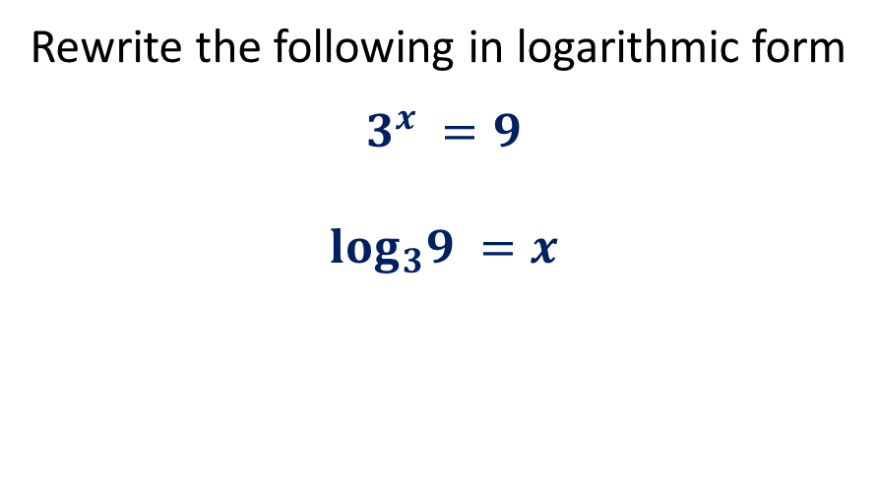

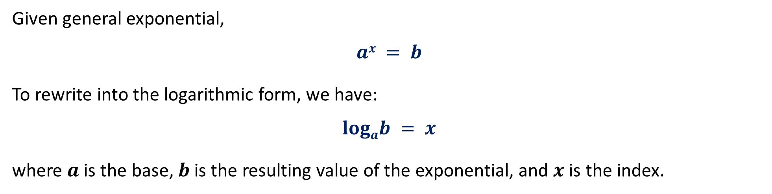

Exponential to Logarithmic Form
Given general exponential,
$$ax = b$$
To rewrite into the logarithmic form, we have:
$$logab = x$$
where $a$ is the base, $b$ is the resulting value of the exponential, and $x$ is the index.
Example
Rewrite the following in logarithmic form
$$3^{x} =9$$
$$log_{3}9 =x$$
Rewrite the following in index form
$$log_{2}32=x$$
$$2^{x}=32$$

Slide 4




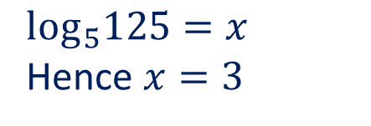
Guided Practice
Write the following in logarithmic form:
$62 = 36$
$5x = 125$
$0.1 ={10}^{−1}$
$4^{\frac{3}{2}} = 8$
$$\log_{6}36{=2}$$
$$\log_{5}125{=x}$$
Hence $x=3$
$$\log_{10}0.1{=−1}$$
$$\log_{4}8{=\frac{3}{2}}$$

Slide 5
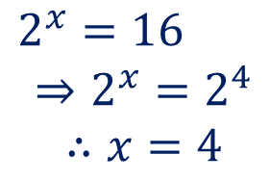





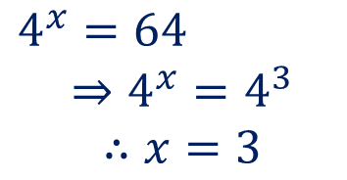

Guided Practice
Write the following in index form and solve for any unknowns:
$log101000000 = 6$
$log464 = x$
$log819 =\frac{1}{2}$
$log644 =\frac{1}{3}$
5. $\log_{2}16 =x$
6. $log381 = x$
$$2^{x}=16$$
$$⇒2^{x}=2^{4}$$
$$∴x=4$$
$${10}^{6}=1000000$$
$$4^{x}=64$$
$$⇒4^{x}=4^{3}$$
$$∴x=3$$
$$3^{x}=81$$
$$⇒3^{x}=3^{4}$$
$$∴x=4$$
$${81}^{\frac{1}{2}}=\sqrt{81}=9$$
$${64}^{\frac{1}{3}}=\sqrt[3]{64}=4$$

Slide 6
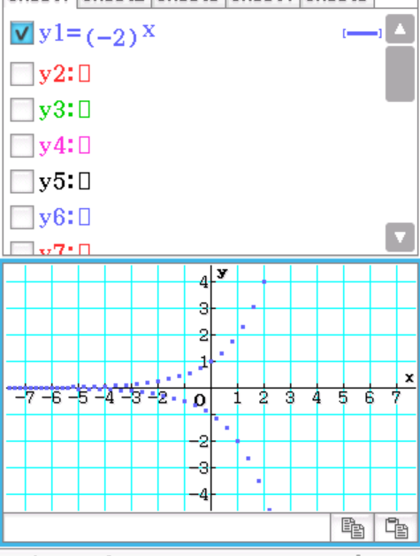
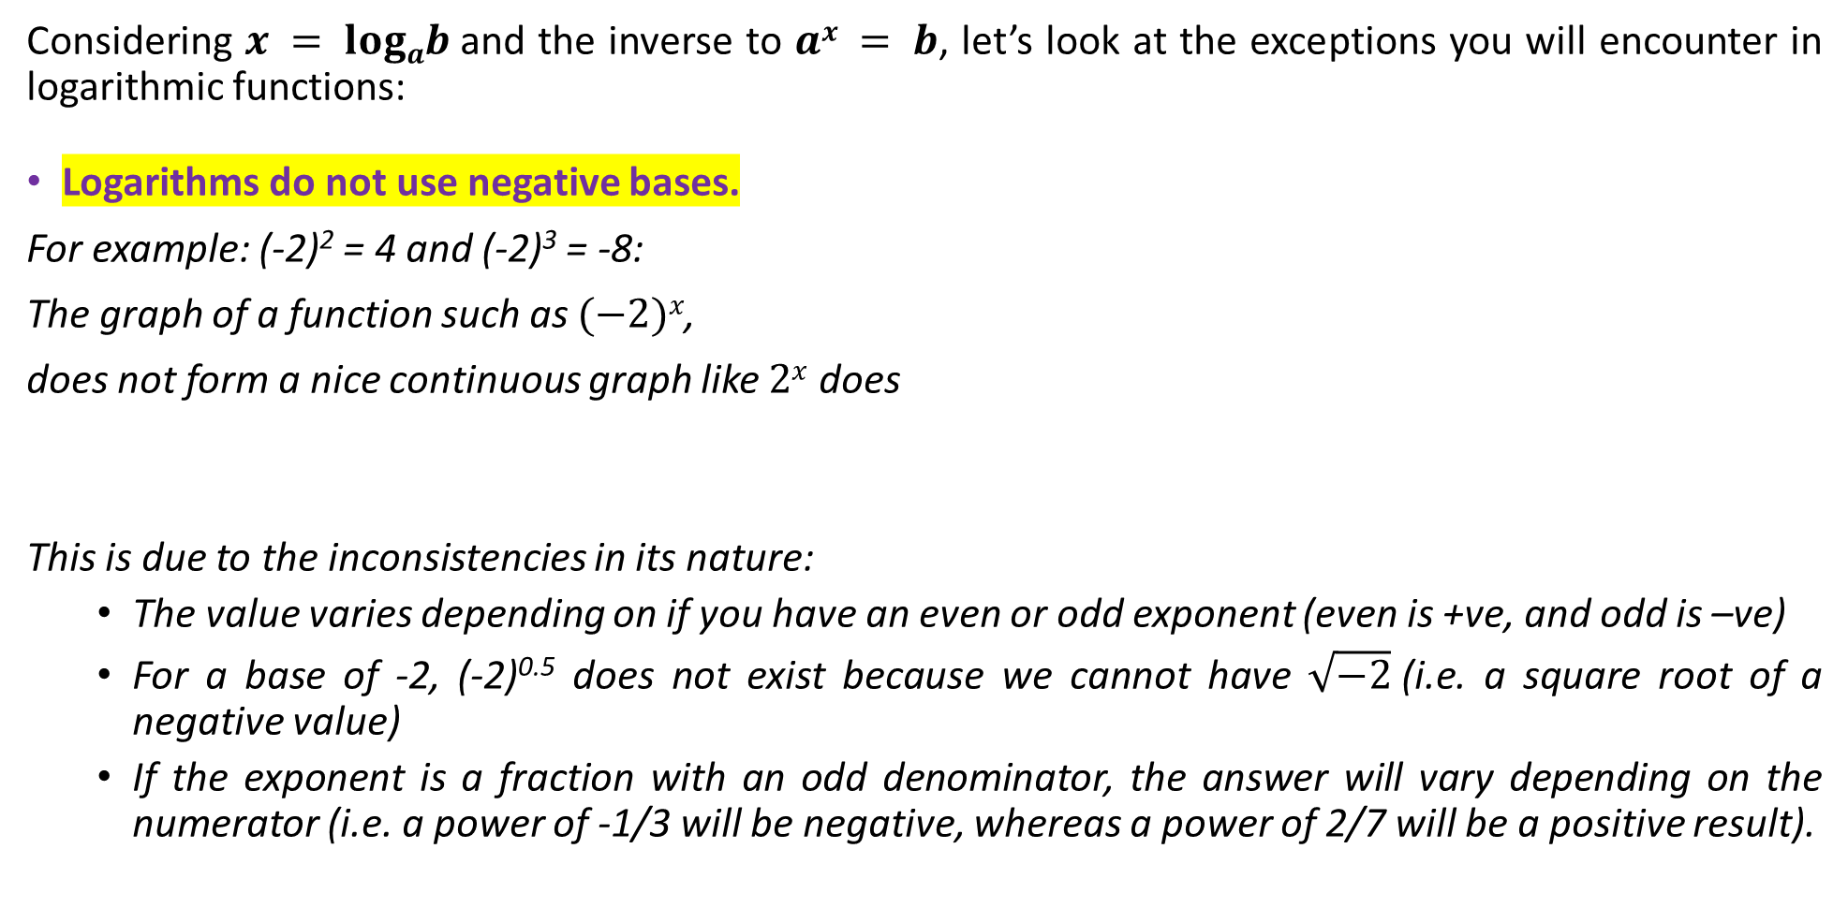
The Properties of Logarithms
Considering $x = logab$and the inverse to $ax = b$, let’s look at the exceptions you will encounter in logarithmic functions:
Logarithms do not use negative bases.
For example: (-2)² = 4 and (-2)³ = -8:
The graph of a function such as $(−2)x$,
does not form a nice continuous graph like $2x$ does
This is due to the inconsistencies in its nature:
The value varies depending on if you have an even or odd exponent (even is +ve, and odd is –ve)
For a base of -2, (-2)^{0.5} does not exist because we cannot have $\sqrt{−2}$(i.e. a square root of a negative value)
If the exponent is a fraction with an odd denominator, the answer will vary depending on the numerator (i.e. a power of -1/3 will be negative, whereas a power of 2/7 will be a positive result).

Slide 7

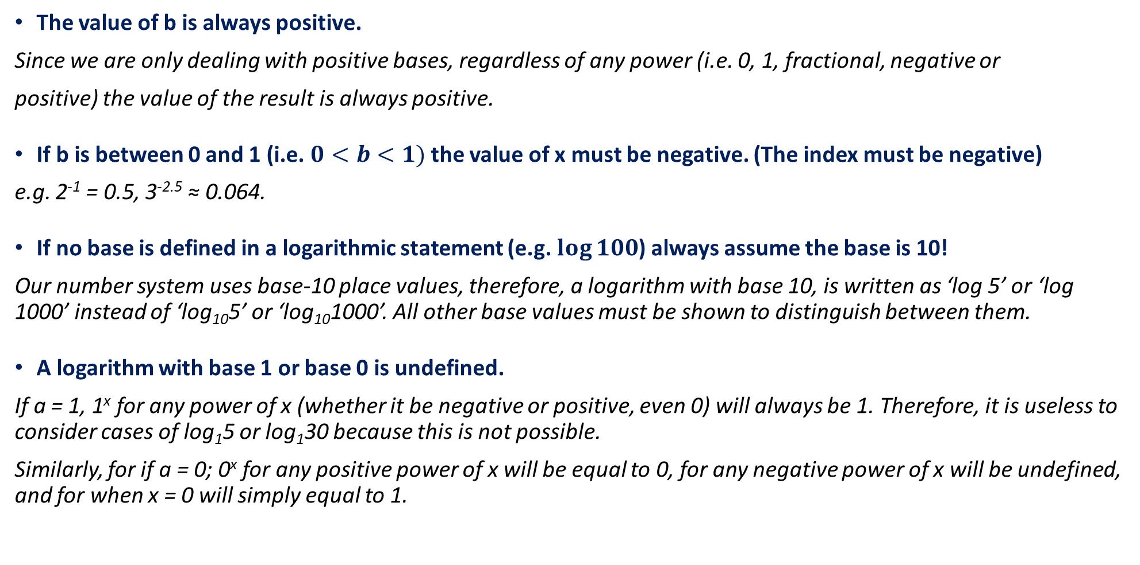
The Properties of Logarithms
$$x = logab or ax = b$$
The value of b is always positive.
Since we are only dealing with positive bases, regardless of any power (i.e. 0, 1, fractional, negative or
positive) the value of the result is always positive.
If b is between 0 and 1 (i.e. $0<b<1)$ the value of x must be negative. (The index must be negative)
e.g. 2⁻¹ = 0.5, 3^{-2.5} ≈ 0.064.
If no base is defined in a logarithmic statement (e.g. $\log{100}$) always assume the base is 10!
Our number system uses base-10 place values, therefore, a logarithm with base 10, is written as ‘log 5’ or ‘log 1000’ instead of ‘log₁₀5’ or ‘log₁₀1000’. All other base values must be shown to distinguish between them.
A logarithm with base 1 or base 0 is undefined.
If a = 1, 1^{x} for any power of x (whether it be negative or positive, even 0) will always be 1. Therefore, it is useless to consider cases of log₁5 or log₁30 because this is not possible.
Similarly, for if a = 0; 0^{x} for any positive power of x will be equal to 0, for any negative power of x will be undefined, and for when x = 0 will simply equal to 1.

Slide 8






Guided Practice
Without the use of a calculator, evaluate the following logarithmic statements:
$\log{1000}$
$\log{0.0001}$
$\log_{2}{64}$
$\log_{3}{81}$
$\log_{2}{\frac{1}{32}}$
$$=3$$
$$=−4$$
$$=6$$
$$=4$$
$$=−5$$

Slide 9
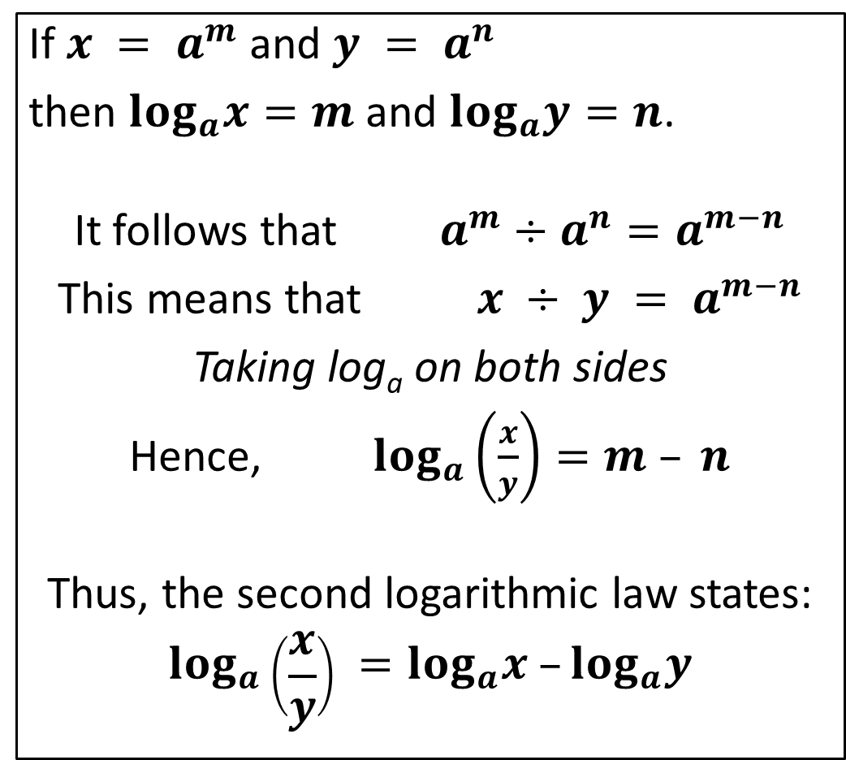
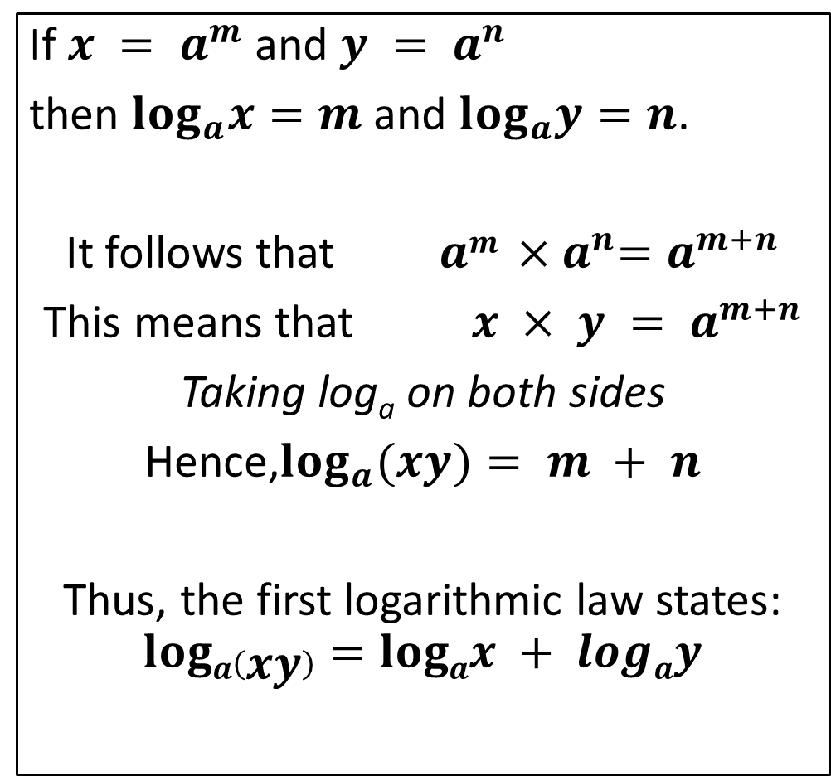
Logarithms Laws 1 & 2
LOGARITHM LAW 1
LOGARITHM LAW 2
If $x = a^{m}$and $y = a^{n}$
then $log_{a}x=m$and $log_{a}y=n$.
It follows that $am {×a}^{n}=a^{m+n}$
This means that $x × y = a^{m+n}$
Taking log_{a} on both sides
Hence,$log_{a}(xy)= m + n$
Thus, the first logarithmic law states:
$$loga\left(xy\right)=logax + logay$$
If $x = a^{m}$and $y = a^{n}$
then $log_{a}x=m$and $log_{a}y=n$.
It follows that $a^{m}÷a^{n}=a^{m−n}$
This means that $x ÷ y = a^{m−n}$
Taking log_{a} on both sides
Hence, $log_{a}\left(\frac{x}{y}\right)=m – n$
Thus, the second logarithmic law states:
$$log_{a}\left(\frac{x}{y}\right) =log_{a}x –log_{a}y$$

Slide 10
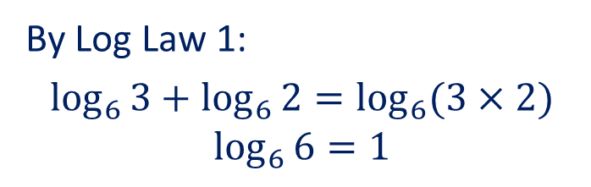
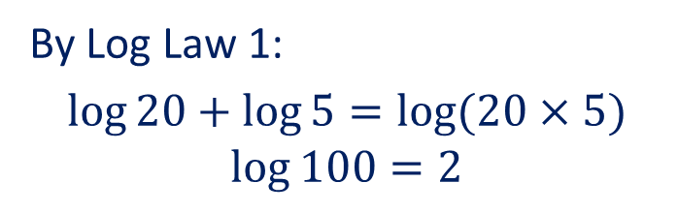
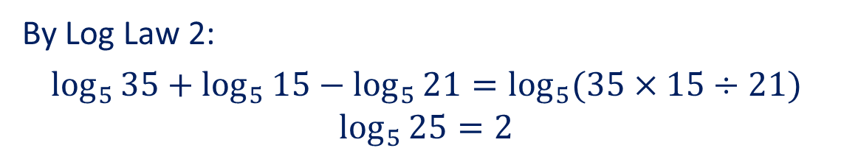
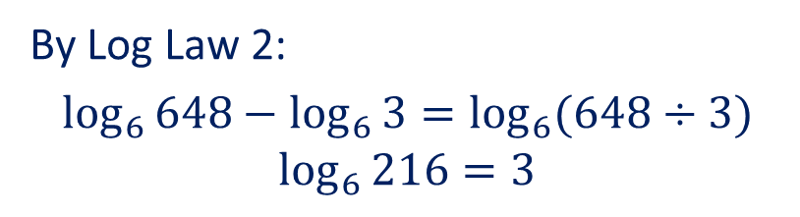
Guided Practice
Evaluate the following without the use of a calculator:
log 20 + log 5
log₆3 + log₆2
log₆648 – log₆3
log₅35 + log₅15 – log₅21
By Log Law 1:
$$\log{20+\log{5}=\log{(20×5)}}$$
$$\log{100}=2$$
By Log Law 1:
$$\log_{6}{3}+\log_{6}{2}=\log_{6}{(3×2)}$$
$$\log_{6}{6}=1$$
By Log Law 2:
$$\log_{6}{648}−\log_{6}{3}=\log_{6}{(648÷3)}$$
$$\log_{6}{216}=3$$
By Log Law 2:
$$\log_{5}{35}+\log_{5}{15}−\log_{5}{21}=\log_{5}{(35×15÷21)}$$
$$\log_{5}{25}=2$$

Slide 11
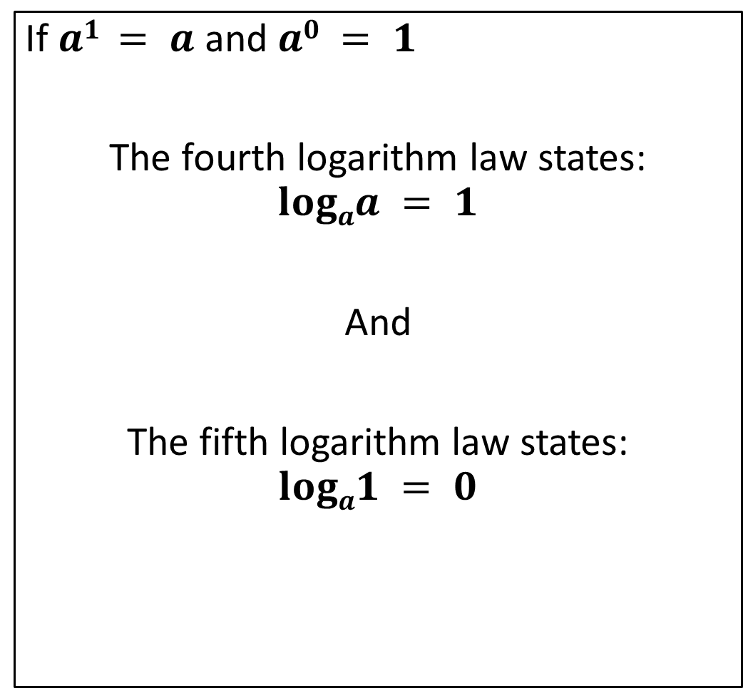
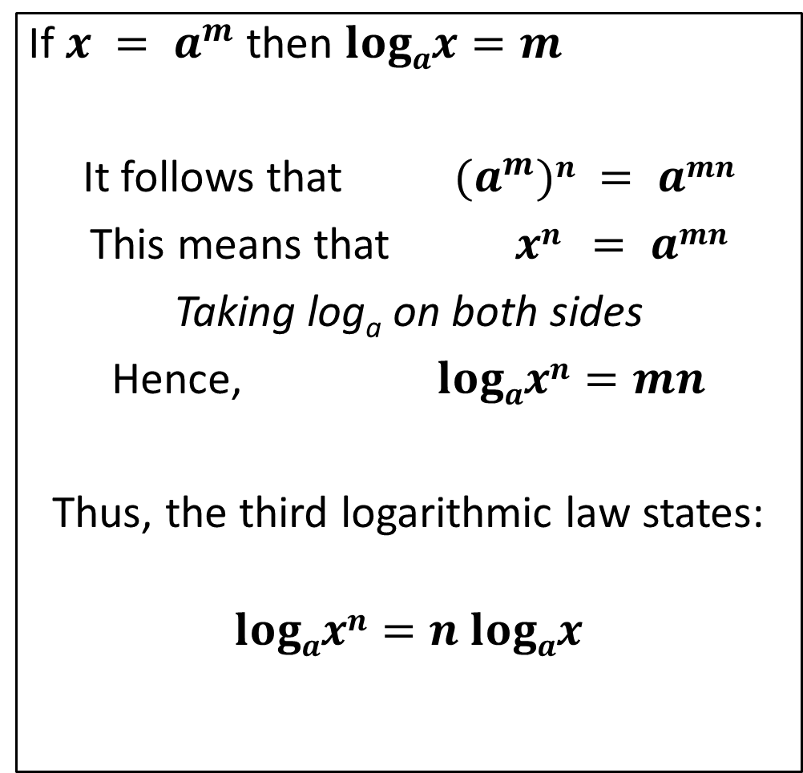
Logarithms Laws 3, 4 & 5
LOGARITHM LAW 3
LOGARITHM LAWS 4 AND 5
If $x = a^{m}$then $logax=m$
It follows that $(a^{m})n = amn$
This means that $xn = amn$
Taking log_{a} on both sides
Hence, $logaxn=mn$
Thus, the third logarithmic law states:
$$logaxn=n logax$$
If $a1 = a$and $a0 = 1$
The fourth logarithm law states:
$$logaa = 1$$
And
The fifth logarithm law states:
$$loga1 = 0$$

Slide 12
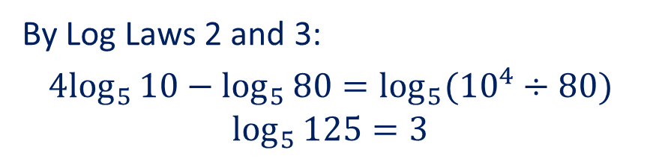
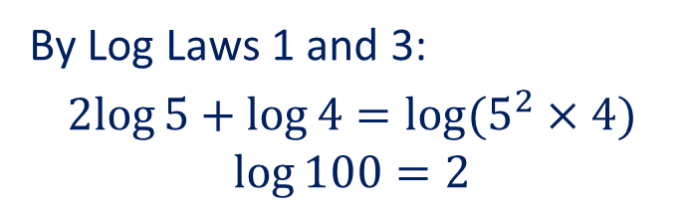
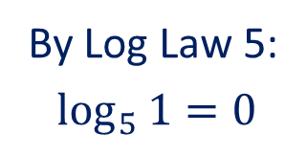
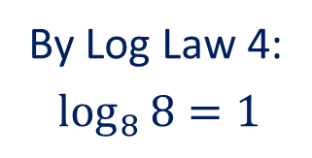
Guided Practice
Evaluate the following without the use of a calculator:
2 log5 + log4
4 log₅10 – log₅80
log₈8
log₅1
By Log Laws 1 and 3:
$$2log{5+\log{4}=\log{(5^{2}×4)}}$$
$$\log{100}=2$$
By Log Laws 2 and 3:
$${4log}_{5}{10}−\log_{5}{80}=\log_{5}{({10}^{4}÷80)}$$
$$\log_{5}{125}=3$$
By Log Law 4:
$$\log_{8}{8}=1$$
By Log Law 5:
$$\log_{5}{1}=0$$

Slide 13

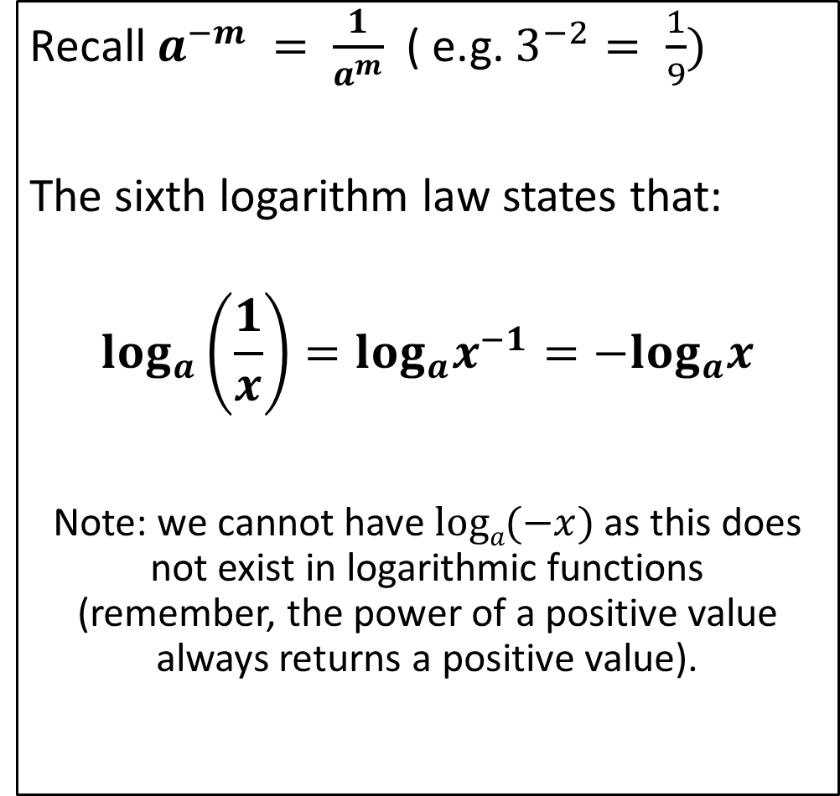
Logarithms Laws 6 & 7
LOGARITHM LAW 6
LOGARITHM LAWS 7
Recall $a^{−m} = \frac{1}{a^{m}}$( e.g. $3^{−2}= \frac{1}{9})$
The sixth logarithm law states that:
$$log_{a}\left(\frac{1}{x}\right)=log_{a}x^{−1}=−log_{a}x$$
Note: we cannot have $loga(−x)$as this does not exist in logarithmic functions (remember, the power of a positive value always returns a positive value).
The seventh logarithm law states:
$$logaam = m$$

Slide 14



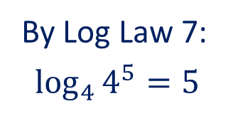
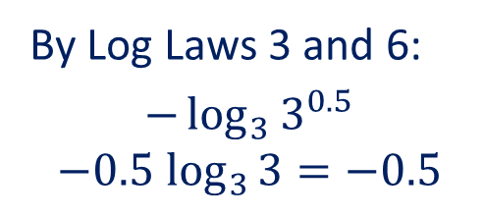
Guided Practice
Evaluate the following without the use of a calculator:
log₂($\frac{1}{2}$)
log₃($\frac{1}{\sqrt{3}}$)
log₄4⁵
log₅$\sqrt{5}$
By Log Law 6:
$$−\log_{2}{2=−1}$$
By Log Laws 3 and 6:
$$−\log_{3}{3^{0.5}}$$
$${−0.5 log}_{3}{3}=−0.5$$
By Log Law 7:
$$\log_{4}{4^{5}}=5$$
By Log Law 7:
$$\log_{5}{\sqrt{5}}=0.5$$

Slide 15
Guided Practice
Evaluate the following without the use of a calculator:
log₂($\frac{1}{2}$)
log₃($\frac{1}{\sqrt{3}}$)
log₄4⁵
log₅$\sqrt{5}$
By Log Law 6:
$$−\log_{2}{2=−1}$$
By Log Laws 3 and 6:
$$−\log_{3}{3^{0.5}}$$
$${−0.5 log}_{3}{3}=−0.5$$
By Log Law 7:
$$\log_{4}{4^{5}}=5$$
By Log Law 7:
$$\log_{5}{\sqrt{5}}=0.5$$

Slide 16


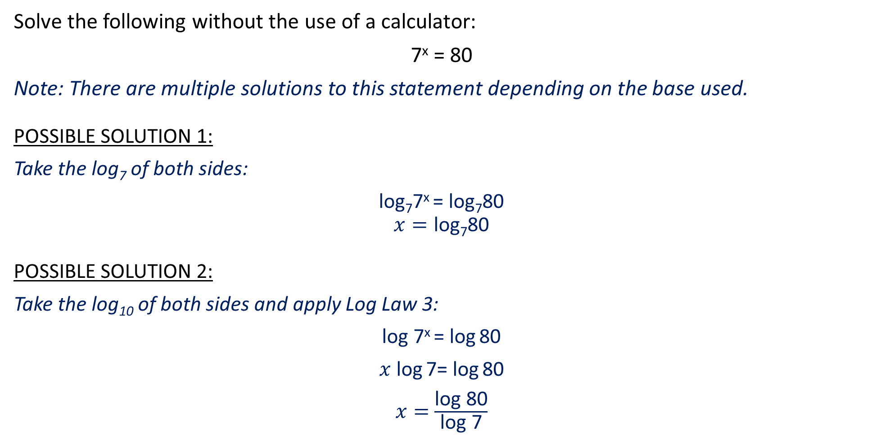
Guided Practice
Solve the following without the use of a calculator:
7^{x} = 80
Note: There are multiple solutions to this statement depending on the base used.
POSSIBLE SOLUTION 1:
Take the log₇ of both sides:
log₇7^{x} = log₇80
$$x=\text{log}\text{7}\text{80}$$
POSSIBLE SOLUTION 2:
Take the log₁₀ of both sides and apply Log Law 3:
log 7^{x} = log 80
$x$ log 7= log 80
$x=$ $\frac{\text{log} \text{80}}{\text{log} \text{7}}$

Slide 17
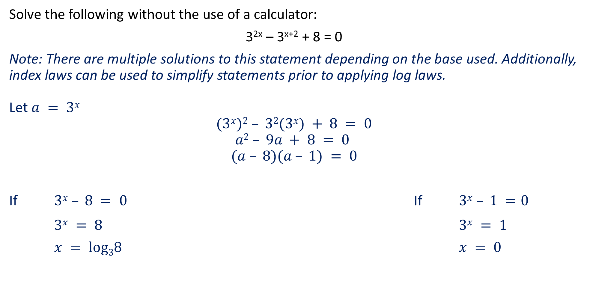
Guided Practice
Solve the following without the use of a calculator:
3^{2x} – 3^{x+2} + 8 = 0
Note: There are multiple solutions to this statement depending on the base used. Additionally, index laws can be used to simplify statements prior to applying log laws.
Let $a = 3x$
$$(3x)2 – 32(3x) + 8 = 0$$
$$a2 – 9a + 8 = 0$$
$$(a – 8)(a – 1) = 0$$
If $3x – 8 = 0$ If $3x – 1 =0$
$3x = 8$ $3x = 1$
$x = log38$ $x = 0$

Slide 18
Guided Practice
Solve each of the following without the use of a calculator, giving your answers in exact form involving logarithms to the base ten:
10^{x} = 27
2^{x} = 70
8^{x –} ¹ = 7
4^{3x} = 5^{x + 2}
5^{x} + 4(5^{x + 1}) = 63

Slide 19
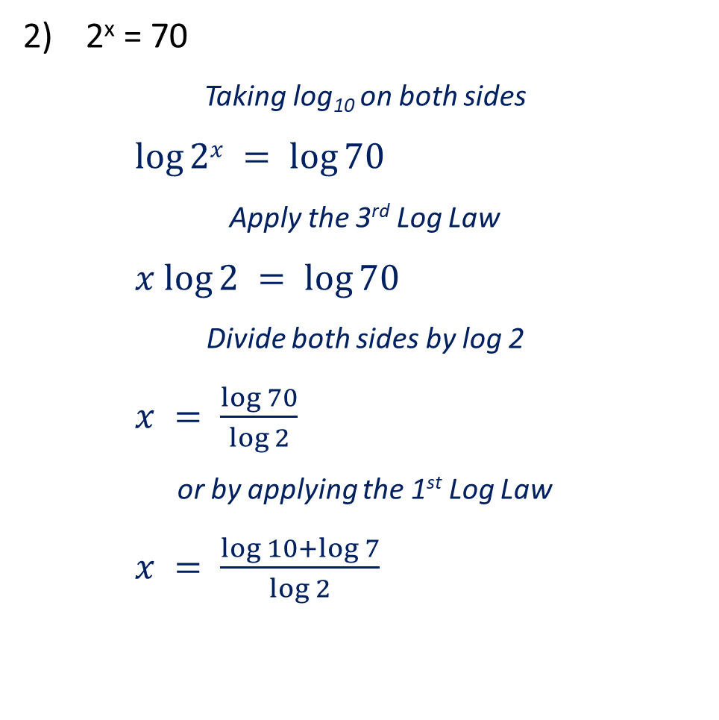
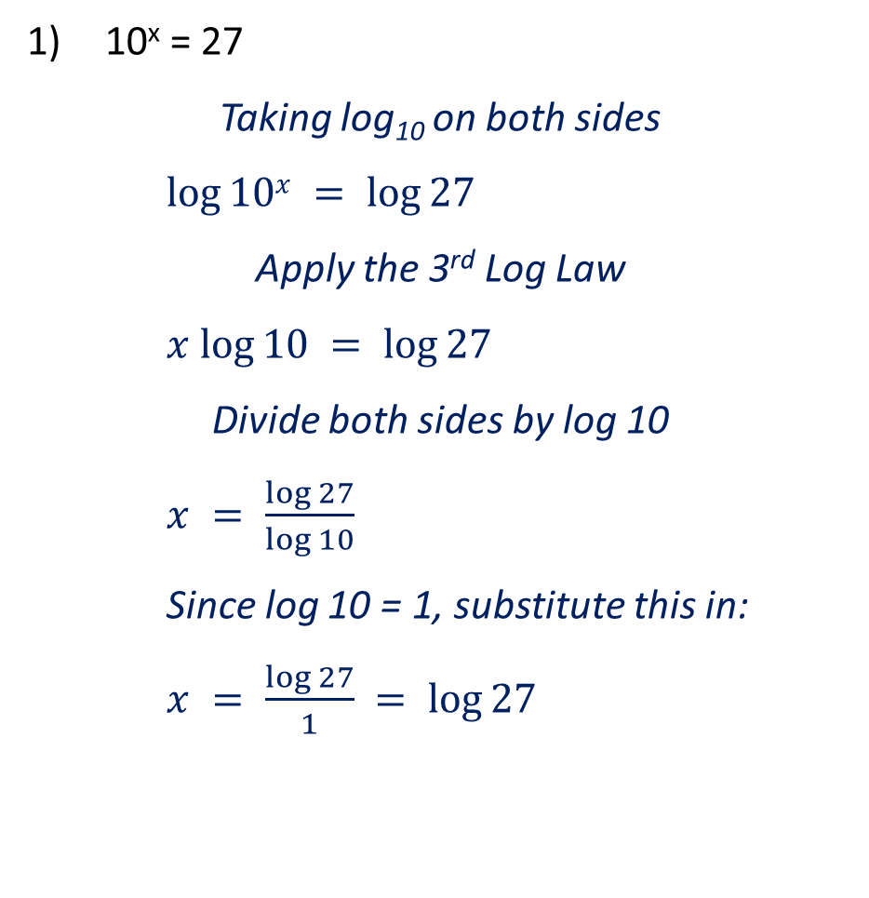
Guided Practice
10^{x} = 27
Taking log₁₀ on both sides
$log⁡10x = log⁡27$
Apply the 3rd Log Law
$x log⁡10 = log⁡27$
Divide both sides by log 10
$x = \frac{\log{27}}{\log{10}}$
Since log 10 = 1, substitute this in:
$x = \frac{\log{27}}{1} = log⁡27$
2^{x} = 70
Taking log₁₀ on both sides
$log⁡2x = log⁡70$
Apply the 3rd Log Law
$x log⁡2 = log⁡70$
Divide both sides by log 2
$x = \frac{\log{70}}{\log{2}}$
or by applying the 1st Log Law
$x = \frac{\log{10+\log{7}}}{\log{2}}$

Slide 20
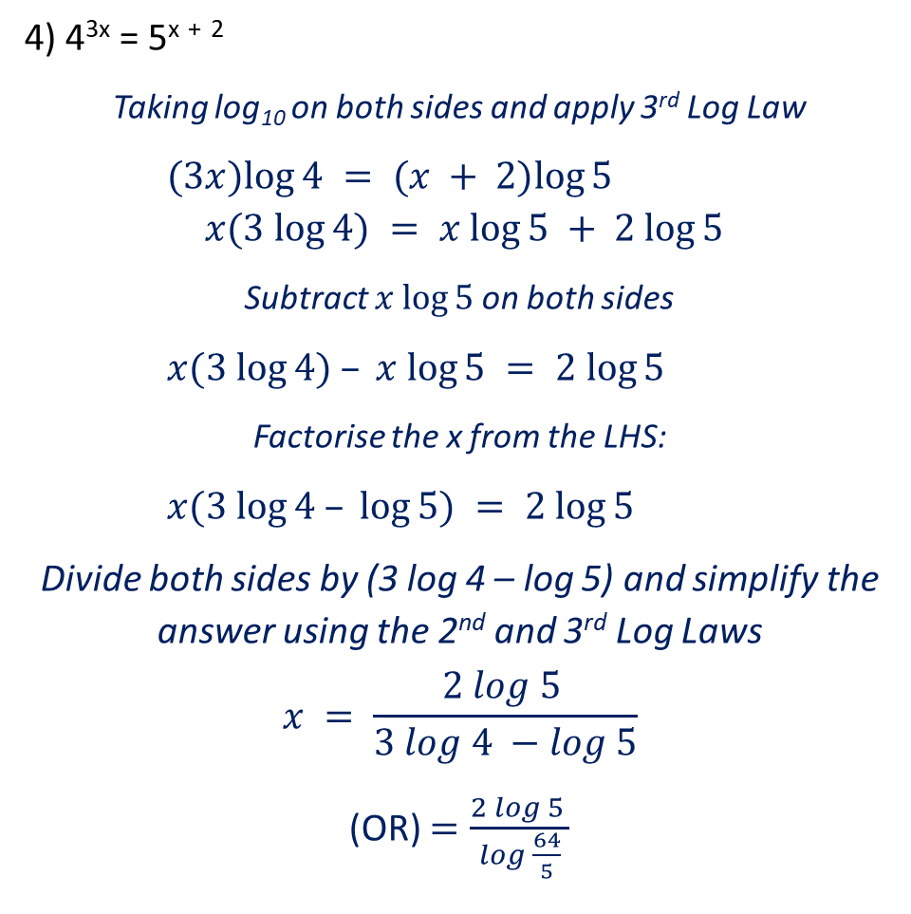
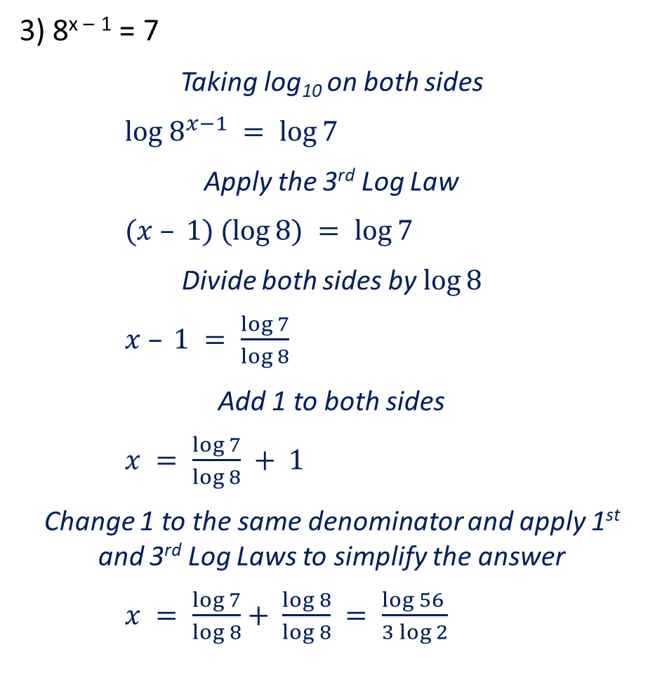
Guided Practice
3) 8^{x –} ¹ = 7
Taking log₁₀ on both sides
$log 8^{x−1} = log⁡7$
Apply the 3rd Log Law
$(x – 1) (log⁡8) = log⁡7$
Divide both sides by$log⁡8$
$x – 1 = \frac{\log{7}}{\log{8}}$
Add 1 to both sides
$x = \frac{\log{7}}{\log{8}} + 1$
Change 1 to the same denominator and apply 1st and 3rd Log Laws to simplify the answer
$x = \frac{\log{7}}{log 8}+ \frac{log 8}{log 8} = \frac{log 56 }{3 log 2}$
4) 4^{3x} = 5^{x} ⁺ ²
Taking log₁₀ on both sides and apply 3rd Log Law
$(3x)log⁡4 = (x + 2)log⁡5$
$$x(3 log⁡4) = x log⁡5 + 2 log⁡5$$
Subtract $x log⁡5$on both sides
$x(3 log⁡4) – x log⁡5 = 2 log⁡5$
Factorise the x from the LHS:
$x(3 log⁡4 – log⁡5) = 2 log⁡5$
Divide both sides by (3 log 4 – log 5) and simplify the answer using the 2nd and 3rd Log Laws
$$x = \frac{2 log 5 }{3 log 4 −log 5}$$
(OR) $=\frac{2 log 5 }{log \frac{64}{5}}$

Slide 21

Guided Practice
5) 5^{x} + 4(5^{x + 1}) = 63
Rewrite the bracketed statement using the 1st Index Law
$$5x + 4(5x × 5) = 63$$
Factorise 5^{x} from the LHS
$$5x(1 + (4 × 5)) = 63$$
$$5x(21) = 63$$
Divide both sides by 21
$$5x = 3$$
Take the log₁₀ of both sides and rearrange
$$x log⁡5 = log⁡3$$
$$x = \frac{\log{3}}{\log{5}}$$

Slide 22
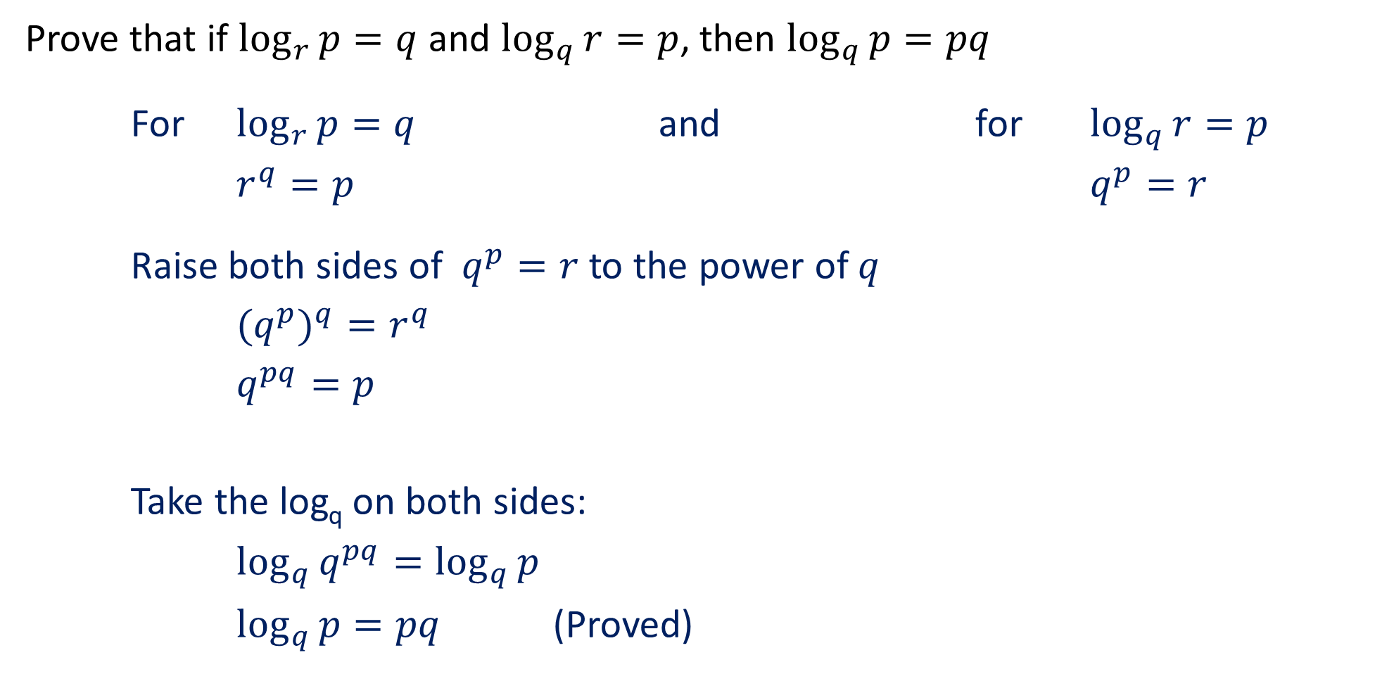
Guided Practice
Prove that if $\log_{r}{p=q}$ and $\log_{q}{r=p}$, then $\log_{q}{p=pq}$
For $\log_{r}{p=q}$ and for $\log_{q}{r=p}$
$r^{q}=p$ $q^{p}=r$
Raise both sides of $q^{p}=r$ to the power of $q$
${{(q}^{p})}^{q}=r^{q}$
$q^{pq}=p$
Take the log_{q} on both sides:
$\log_{q}{q^{pq}=\log_{q}{p}}$
$\log_{q}{p=pq}$ (Proved)

Slide 23
Independent Practice
Complete Jklup Worksheet

